Slide 1
Python Programming - VI
By Nimesh Kumar Dagur, CDAC, India

Slide 2
Working with Files in Python Programming
File is a named location on disk to store related information
While a program is running, its data is in memory.
When the program ends, or the computer shuts down, data in memory disappears.
To store data permanently, you have to put it in a File.
file is used to permanently store data in a non-volatile memory (e.g. hard disk).
Since, random access memory (RAM) is volatile which loses its data when computer is turned off, we use files for future use of the data.

Slide 3
Files are usually stored on a hard drive, floppy drive, or CD-ROM.
When there are a large number of files, they are often organized into directories (also called \folders").
Each file is identified by a unique name, or a combination of a file name and a directory name.
By reading and writing files, programs can exchange information with each other and generate printable formats like PDF.

Slide 4
Working with Files in Python Programming
Working with files is a lot like working with books.
To use a book, you have to open it. When you're done, you have to close it.
While the book is open, you can either write in it or read from it.
In either case, you know where you are in the book.
Most of the time, you read the whole book in its natural order, but you can also skip around.
All of this applies to files as well. To open a file, you specify its name and indicate whether you want to read or write.
Opening a file creates a file object.

Slide 5
Working with Files in Python Programming
In Python, a file operation takes place in the following order.
Open a file
Read or write (perform operation)
Close the file

Slide 6

Opening a File
Python has a built-in function open() to open a file.
This function returns a file object, also called a handle, as it is used to read or modify the file accordingly.
Opening a file creates what we call a file handle.
In this example, the variable f refers to the new handle object.
Our program calls methods on the handle, and this makes changes to
the actual file which is usually located on our disk.

Slide 7
Opening a File
We can specify the mode while opening a file.
In mode, we specify whether we want to read 'r', write 'w' or append 'a' to the file.
We also specify if we want to open the file in text mode or binary mode.
The default is reading in text mode.
In text mode, we get strings when reading from the file.
On the other hand, binary mode returns bytes and this is the mode to be used when dealing with non-text files like image or exe files.

Slide 8
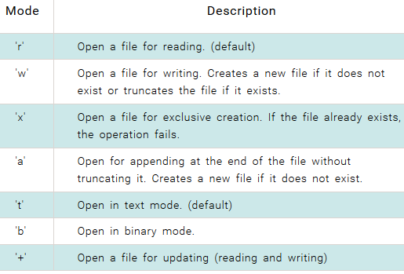
Python File Modes

Slide 9

Python File Modes

Slide 10
Python File Modes
Since the version 3.x, Python has made a clear distinction between str (text) and bytes (8-bits).
Unlike other languages, the character 'a' does not imply the number 97 until it is encoded using ASCII (or other equivalent encodings).
Hence, when working with files in text mode, it is recommended to specify the encoding type.
Files are stored in bytes in the disk, we need to decode them into str when we read into Python.
Similarly, encoding is performed while writing texts to the file.
The default encoding is platform dependent.
In windows, it is 'cp1252' but 'utf-8' in Linux.
Hence, we must not rely on the default encoding otherwise, our code will behave differently in different platforms.

Slide 11
Python File Modes
Thus, this is the preferred way to open a file for reading in text mode.

Slide 12
Writing to a File
In order to write into a file we need to open it in write 'w', append 'a' or exclusive creation 'x' mode.
We need to be careful with the 'w' mode as it will overwrite into the file if it already exists. All previous data are erased.
Writing a string or sequence of bytes (for binary files) is done using write() method.
This method returns the number of characters written to the file.

Slide 13

Writing to a File
This program will create a new file named 'test.txt' if it does not exist.
If it does exist, it is overwritten.
We must include the newline characters ourselves to distinguish different lines

Slide 14
Reading From a File
To read the content of a file, we must open the file in reading mode.
There are various methods available for this purpose.
We can use the read(size) method to read in size number of data.
If size parameter is not specified, it reads and returns up to the end of the file
read() method returns newline as '\n'.
Once the end of file is reached, we get empty string on further reading.

Slide 15
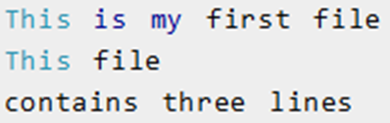
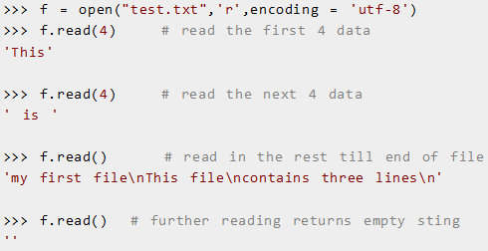
Reading From a File

Slide 16
Reading From a File
We can change our current file cursor (position) using the seek() method.
Similarly, the tell() method returns our current position (in number of bytes).

Slide 17
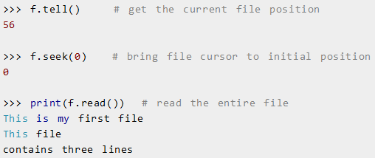
Reading From a File

Slide 18
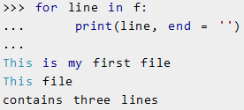
Reading From a File
We can read a file line-by-line using a for loop.
This is both efficient and fast.
The lines in file itself has a newline character '\n'. Moreover, the print() function also appends a newline by default. Hence, we specify the end parameter to avoid two newlines when printing.

Slide 19
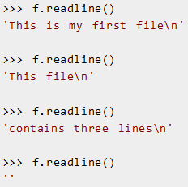
Reading From a File
we can use readline() method to read individual lines of a file.
This method reads a file till the newline, including the newline character.

Slide 20
Reading From a File
The readlines() method returns a list of remaining lines of the entire file.
All these reading method return empty values when end of file (EOF) is reached.

Slide 21

Closing a File
When we are done with operations to the file, we need to properly close it.
Python has a garbage collector to clean up unreferenced objects.
But we must not rely on it to close the file.
Closing a file will free up the resources that were tied with the file and is done using the close() method.

Slide 22
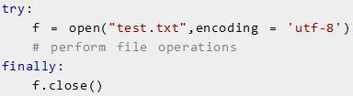
Closing a File
Previous method is not entirely safe.
If an exception occurs when we are performing some operation with the file, the code exits without closing the file.
A safer way is to use a try...finally block.
This way, we are guaranteed that the file is properly closed even if an exception is raised, causing program flow to stop.

Slide 23
Closing a File
The best way to do this is using the with statement.
This ensures that the file is closed when the block inside with is exited.
We don't need to explicitly call the close() method. It is done internally.

Slide 24
Python Directory and Files Management
If there are large number of files in Python, we can place related files in different directories to make things more manageable.
A directory or folder is a collection of files and sub directories.
Files on non-volatile storage media are organized by a set of rules known as a file system.
File systems are made up of files and directories, which are containers for both files and other directories.
Python has the os module, which provides us with many useful methods to work with directories (and files as well).

Slide 25
Get Current Directory
We can get the present working directory using the getcwd() method.
This method returns the current working directory in the form of a string.
We can also use the getcwdb() method to get it as bytes object.

Slide 26
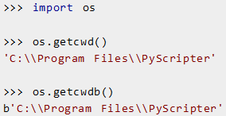

Get Current Directory
The extra backslash implies escape sequence.
The print() function will render this properly.

Slide 27

Changing Directory
We can change the current working directory using the chdir() method.
The new path that we want to change to must be supplied as a string to this method.
We can use both forward slash (/) or the backward slash (\) to separate path elements.
It is safer to use escape sequence when using the backward slash.

Slide 28
List Directories and Files
All files and sub directories inside a directory can be known using the listdir() method.
This method takes in a path and returns a list of sub directories and files in that path.
If no path is specified, it returns from the current working directory.

Slide 29
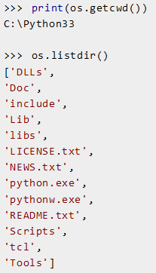
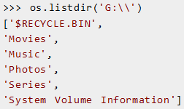

Slide 30

Making a New Directory
We can make a new directory using the mkdir() method.
This method takes in the path of the new directory.
If the full path is not specified, the new directory is created in the current working directory.

Slide 31
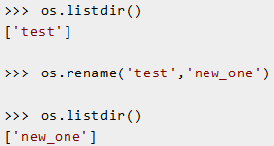
Renaming a Directory or a File
The rename() method can rename a directory or a file.
The first argument is the old name and the new name must be supplies as the second argument.

Slide 32
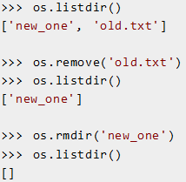
Removing Directory or File
A file can be removed (deleted) using the remove() method.
Similarly, the rmdir() method removes an empty directory.

Slide 33
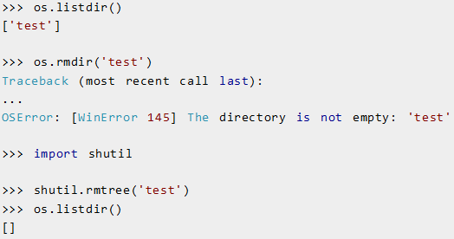
Removing Directory or File
However, note that rmdir() method can only remove empty directories.
In order to remove a non-empty directory we can use the rmtree() method inside the shutil module.

